Slide 1
State Of The Art GaN/TWTA Analog Linearizer Overview
John Sochacki

Slide 2
Outline
Category of GaN/TWTA Analog Pre-Distorter
Narrowband Reflective Single Path
Paper 1
Wideband Reflective Single Path
Paper 1
Wideband Transmissive Single Path
Paper 1 - 2
Wideband Transmissive Dual Path
Paper 1 - 4
Wideband Reflective Transmissive Dual Path
Paper 1
Wideband Unknown
Paper 1 – 2
Best State Of The Art Performance

Slide 3
Outline
Category of GaN/TWTA Analog Pre-Distorter
Narrowband Reflective Single Path
Paper 1
Wideband Reflective Single Path
Paper 1
Wideband Transmissive Single Path
Paper 1 - 2
Wideband Transmissive Dual Path
Paper 1 - 4
Wideband Reflective Transmissive Dual Path
Paper 1
Wideband Unknown
Paper 1 – 2
Best State Of The Art Performance

Slide 4
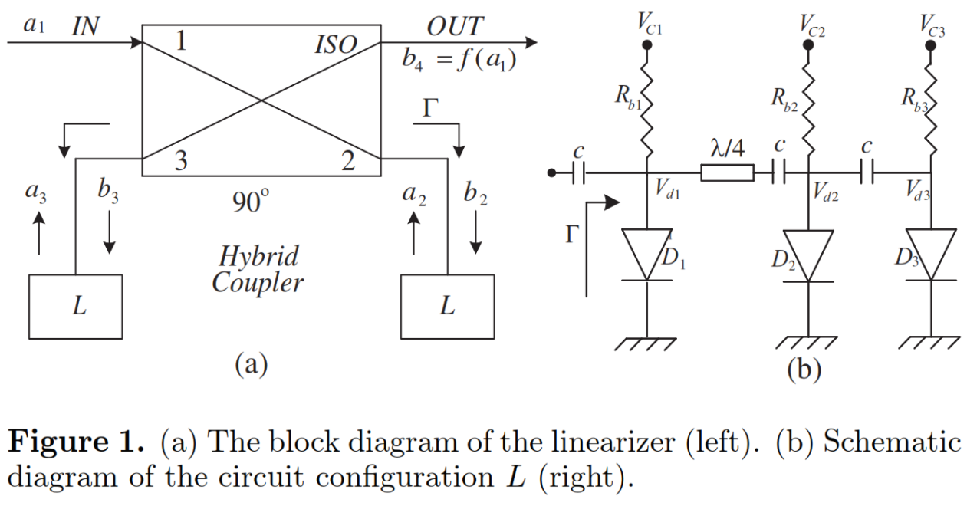
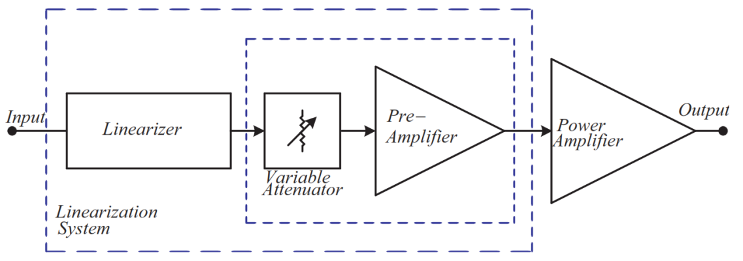
Narrowband Reflective Single Path: Paper 1
The image on the right is the linearizer topology that this paper is demonstrating. The paper is focused on this topology for it’s dual inflection point characteristics (AM-AM gain compression before expansion). The bandwidths that this linearizer is tested over is less than 20 MHz.
The image to the right is the system level diagram of the set up that the tests were performed on.

Slide 5
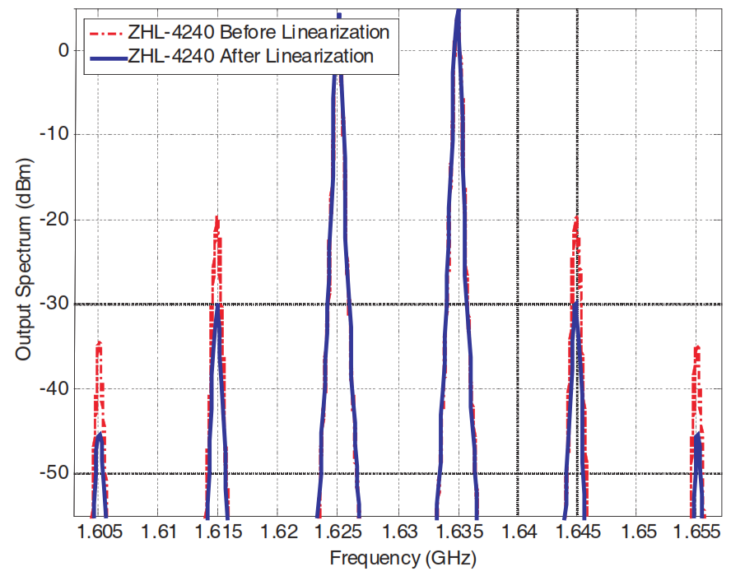
Narrowband Reflective Single Path: Paper 1
The image on the right is the result of the linearizer topology that this paper is demonstrating. It can be seen that this is a very low frequency design and a 10MHz tone spacing was used for the two tone test. There is no more breadth to the results that were reported in this paper.

Slide 6
Outline
Category of GaN/TWTA Analog Pre-Distorter
Narrowband Reflective Single Path
Paper 1
Wideband Reflective Single Path
Paper 1
Wideband Transmissive Single Path
Paper 1 - 2
Wideband Transmissive Dual Path
Paper 1 - 4
Wideband Reflective Transmissive Dual Path
Paper 1
Wideband Unknown
Paper 1 – 2
Best State Of The Art Performance

Slide 7
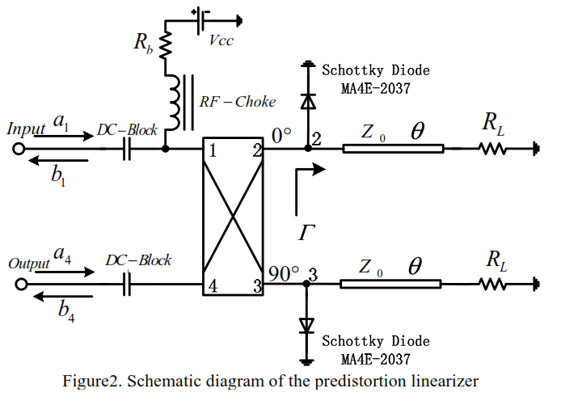
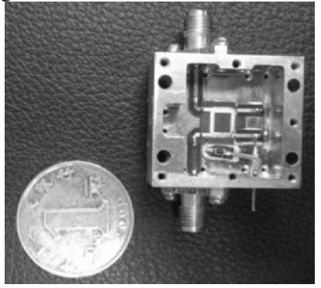
Wideband Reflective Single Path: Paper 1
The image on the right is the linearizer topology that this paper is demonstrating. The paper is focused on this topology for TWTA amplifiers as although the AM-AM characteristics of the pre-distorter are suitable for both TWTA and GaN amplifiers, the natural phase characteristics of this topology can only correct TWTA phase distortion and not GaN phase distortion.

Slide 8
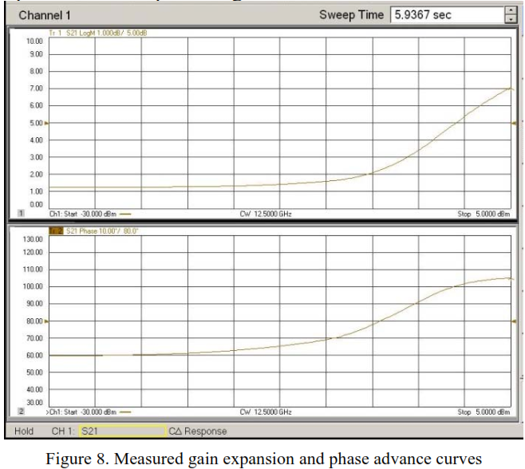
Wideband Reflective Single Path: Paper 1
The image on the right is the result of the linearizer topology that this paper is demonstrating. There is no more breadth to the results that were reported in this paper.

Slide 9
Outline
Category of GaN/TWTA Analog Pre-Distorter
Narrowband Reflective Single Path
Paper 1
Wideband Reflective Single Path
Paper 1
Wideband Transmissive Single Path
Paper 1 - 2
Wideband Transmissive Dual Path
Paper 1 - 4
Wideband Reflective Transmissive Dual Path
Paper 1
Wideband Unknown
Paper 1 – 2
Best State Of The Art Performance

Slide 10
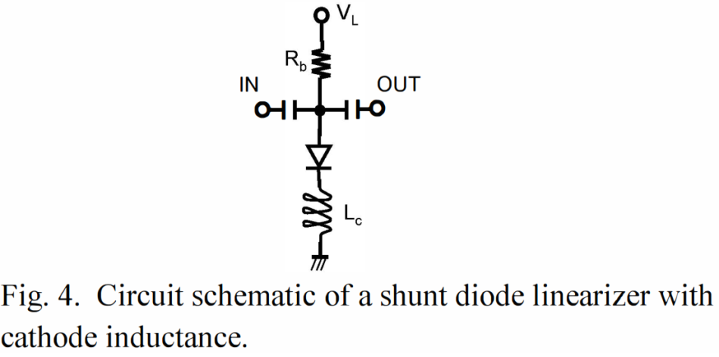
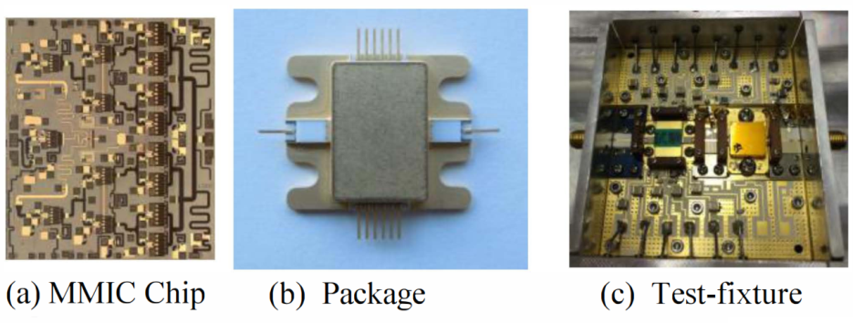
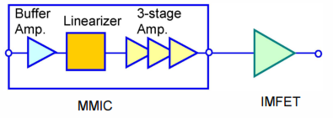
Wideband Transmissive Single Path: Paper 1
The top image on the right is the linearizer topology that this paper is demonstrating. The paper is focused on this topology for it’s small size to enable integration into GaN amplifier MMICs. Note: it’s natural phase distortion is not suited for correction of GaN phase distortion. Although it is used for GaN linearzation it is only able to correct for AM-AM distortion and actually adds to AM-PM distortion as will be seen in four slides.

Slide 11
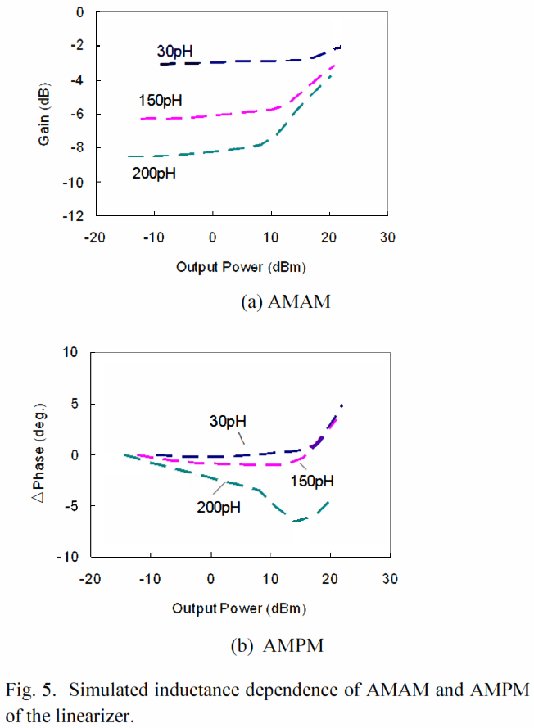
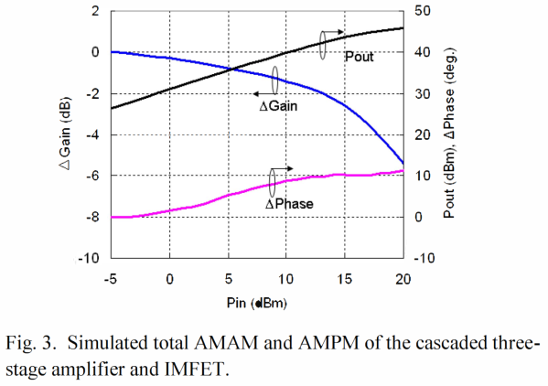
Wideband Reflective Single Path: Paper 1
The image on the right is the result of the linearizer topology that this paper is demonstrating with varied cathode inductances. Note that these inductances are in the pico henries and are therefore only suitable for MMIC based linearizers.
The image below is the AM-AM and AM-PM of the un-linearized MMIC – IMFET cascade.

Slide 12
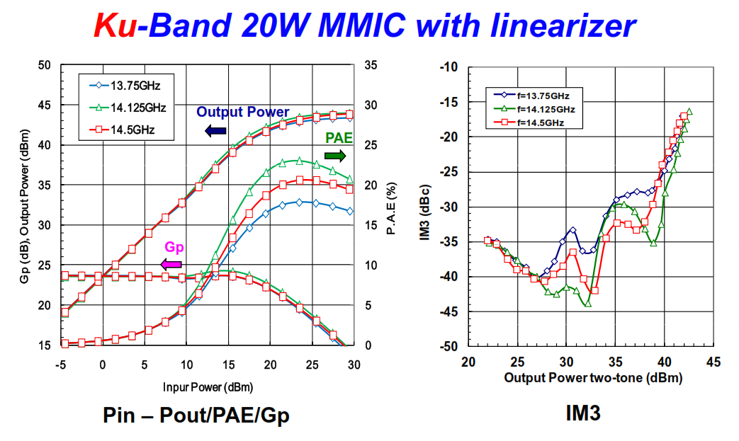
Wideband Transmissive Single Path: Paper 1
The images on the right are the AM-AM, PAE, and output power response of the linearized MMIC and the IM3 response of the linearized MMIC.

Slide 13
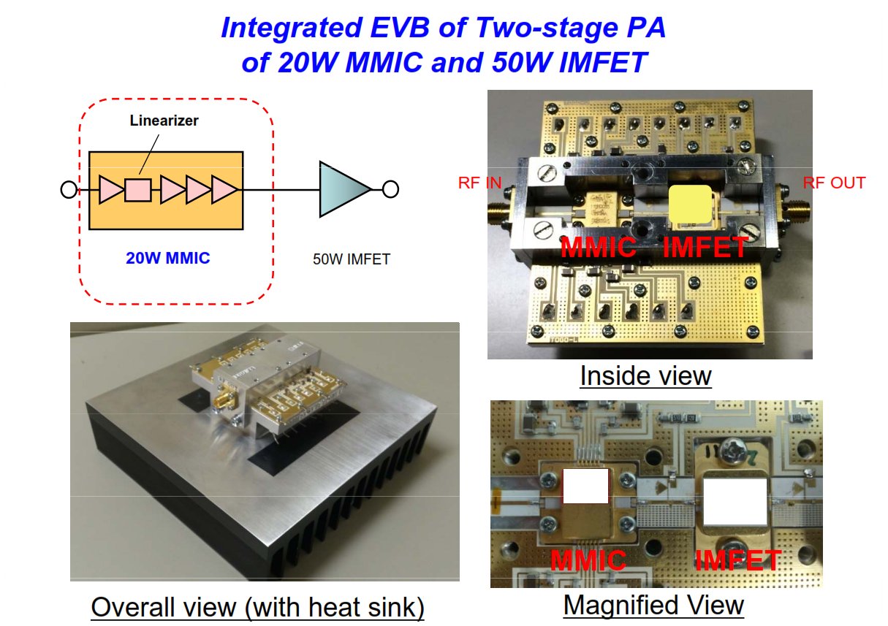
Wideband Transmissive Single Path: Paper 1
The image on the right is the system set up that the tests were performed on.

Slide 14
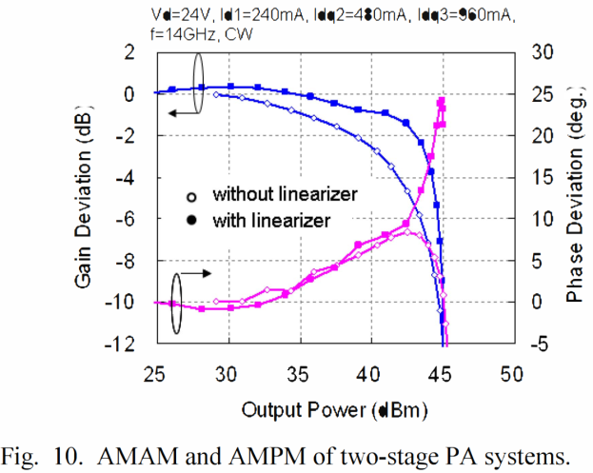
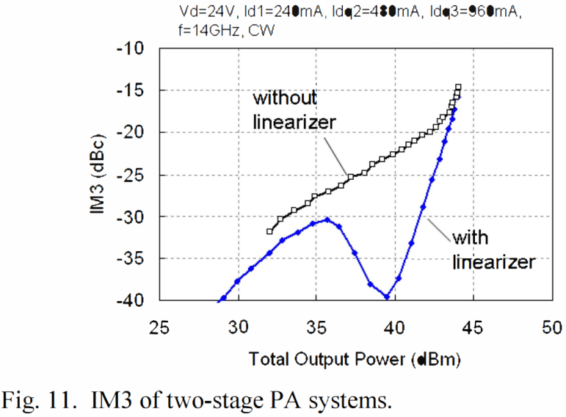
Wideband Reflective Single Path: Paper 1
The image on the left below is the AM-AM and AM-PM of the linearized MMIC – IMFET cascade at one frequency while the image below on the right is the comparison of the IM3 of the non-linearized cascade with the IM3 of the linearized cascade at one frequency. Note: although the output FET is a 50W IMFET and should yeild no less than 47 dBm, the Psat is at 45 dBm due not to the linearizer but rather the 20W MMIC driver’s Psat.

Slide 15
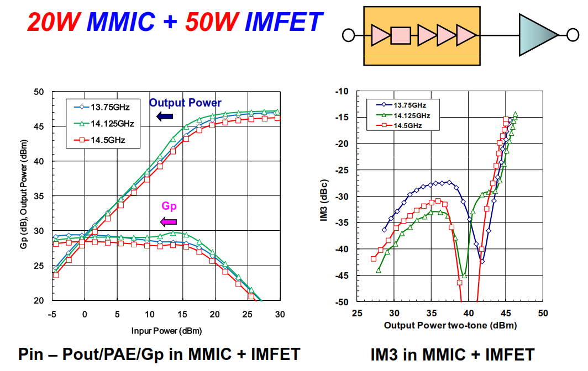
Wideband Transmissive Single Path: Paper 1
The images on the right are the AM-AM, PAE, and output power response of the linearized MMIC – IMFET cascade and the IM3 response of the linearized MMIC – IMFET cascade.

Slide 16
Outline
Category of GaN/TWTA Analog Pre-Distorter
Narrowband Reflective Single Path
Paper 1
Wideband Reflective Single Path
Paper 1
Wideband Transmissive Single Path
Paper 1 - 2
Wideband Transmissive Dual Path
Paper 1 - 4
Wideband Reflective Transmissive Dual Path
Paper 1
Wideband Unknown
Paper 1 – 2
Best State Of The Art Performance

Slide 17
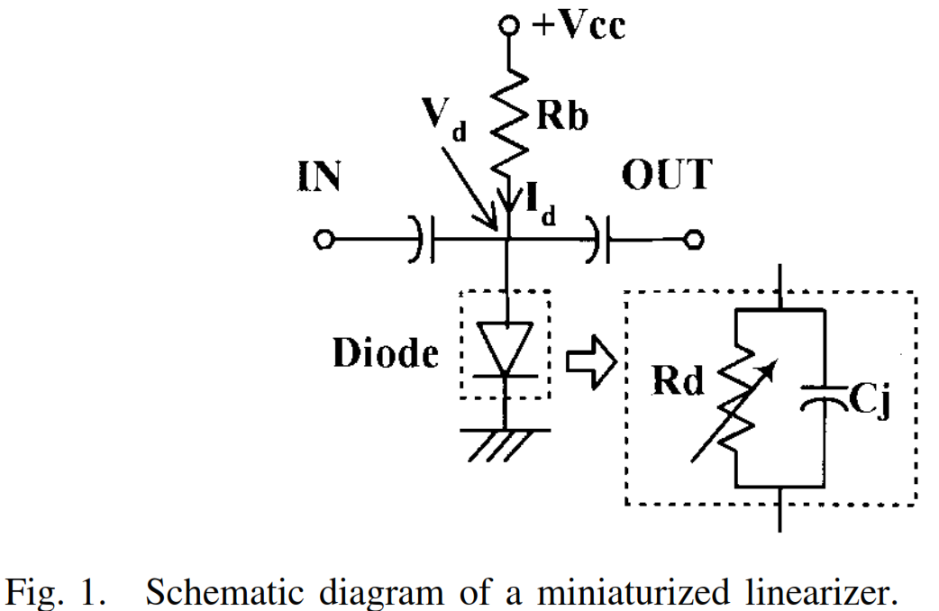
Wideband Transmissive Single Path: Paper 2
The image on the right is the linearizer topology that this paper is demonstrating. The paper is focused on this topology for it’s small size when implemented in lower frequency (sub C-Band) systems.

Slide 18
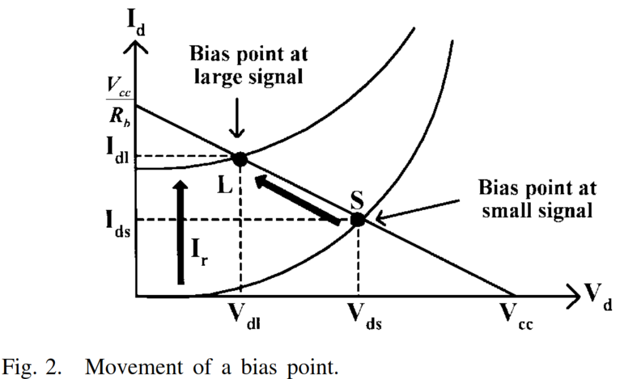
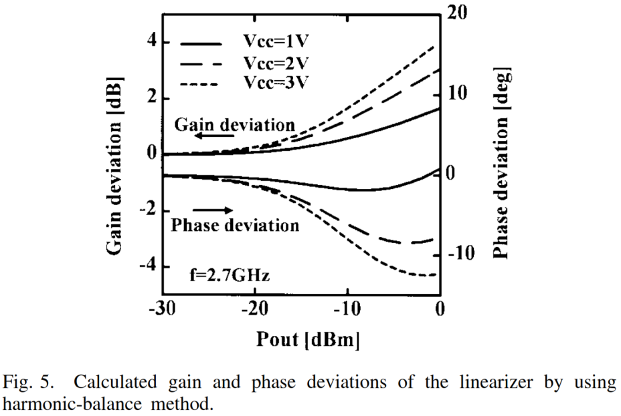
Wideband Transmissive Single Path: Paper 2
The image on the right at the top is a small bit of the theory behind the operation of the linearizer and the image at the bottom is the AM-AM and AM-PM response of the linearizer for a few different bias settings.

Slide 19
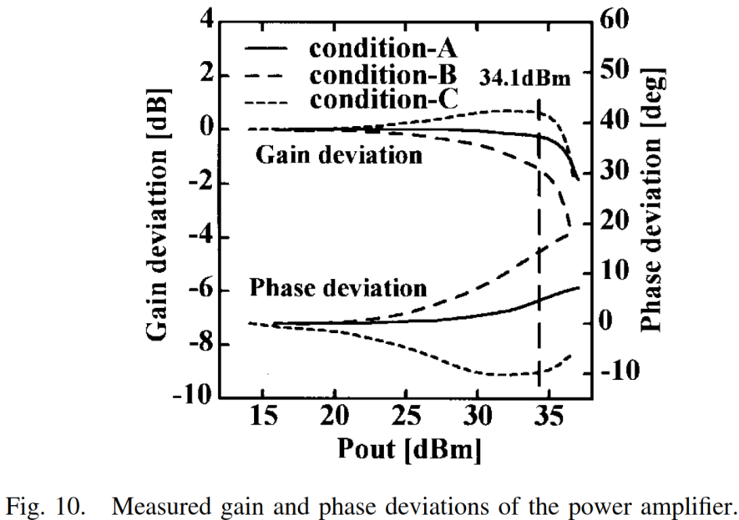
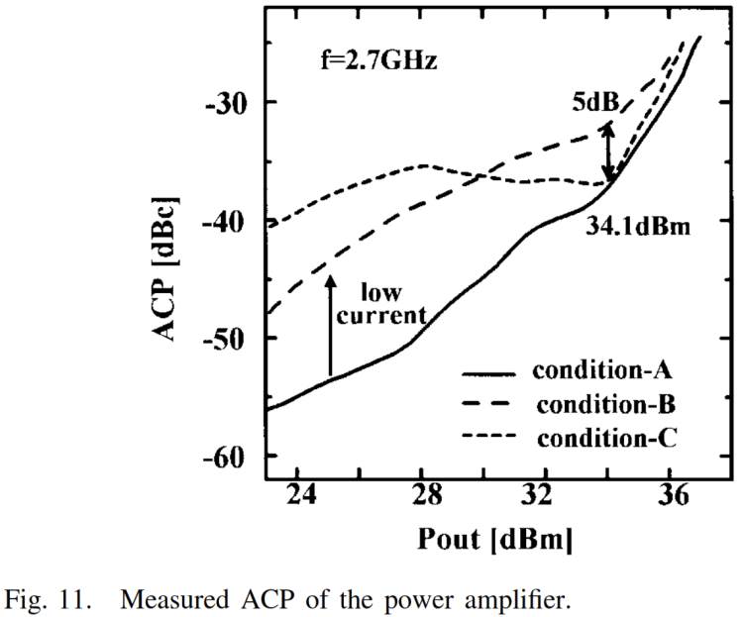
Wideband Transmissive Single Path: Paper 2
The image on the right at the top is the AM-AM and AM-PM response of the linearized cascade for a few different bias settings and the image on the right at the bottom is the ACP of the cascade against the output power of the cascade for a few different bias settings.

Slide 20
Outline
Category of GaN/TWTA Analog Pre-Distorter
Narrowband Reflective Single Path
Paper 1
Wideband Reflective Single Path
Paper 1
Wideband Transmissive Single Path
Paper 1 - 2
Wideband Transmissive Dual Path
Paper 1 - 4
Wideband Reflective Transmissive Dual Path
Paper 1
Wideband Unknown
Paper 1 – 2
Best State Of The Art Performance

Slide 21
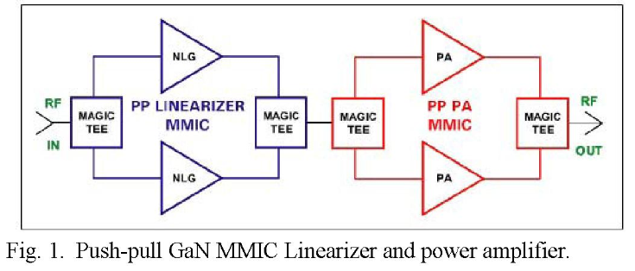
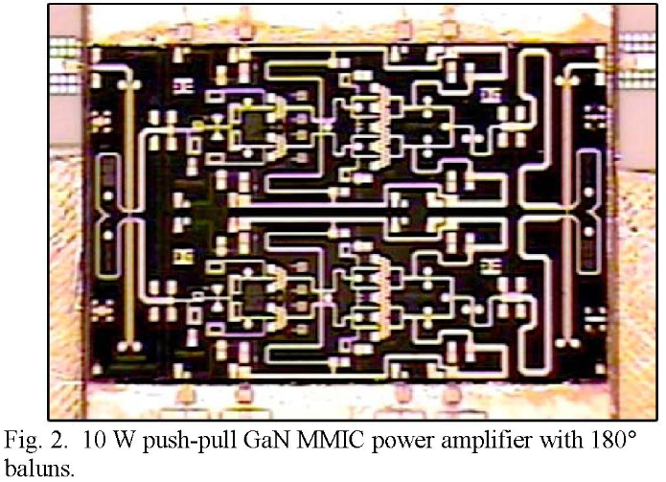
Wideband Transmissive Dual Path: Paper 1
The image on the right at the top is the linearizer topology that this paper is demonstrating. The paper is focused on this topology for it’s second harmonic supression as it’s intended market is very wideband amplifiers where the second harmonic of the lower portion of the amplifier bandwidth is within the upper portion of the amplifier bandwidth. The image on the right at the bottom is the push pull power amplifier MMIC.

Slide 22
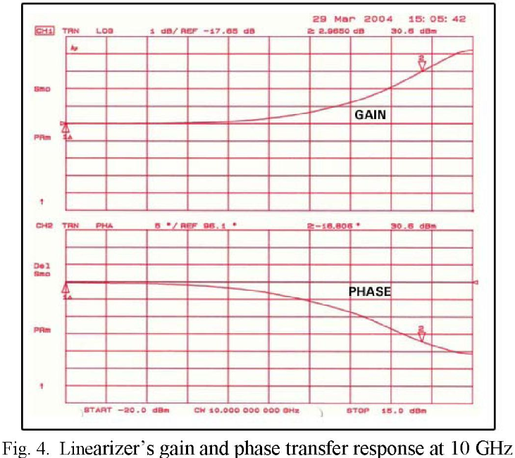
Wideband Transmissive Dual Path: Paper 1
The image on the right the AM-AM and AM-PM response of the linearizer in the middle of the amplifiers bandwidth. Note the amplifier bandwidth is 6 GHz to 16 GHz.

Slide 23
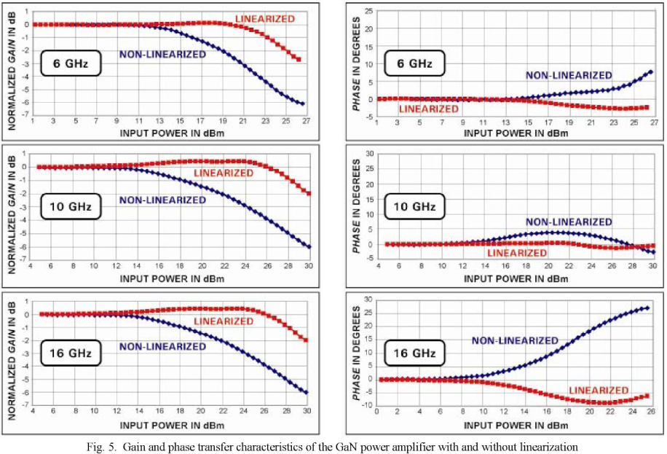
Wideband Transmissive Dual Path: Paper 1
The image on the right is a comparison of the AM-AM and AM-PM response of the non-linearized cascade and the linearized cascade at the low, mid, and high frequencies of the cascade.

Slide 24
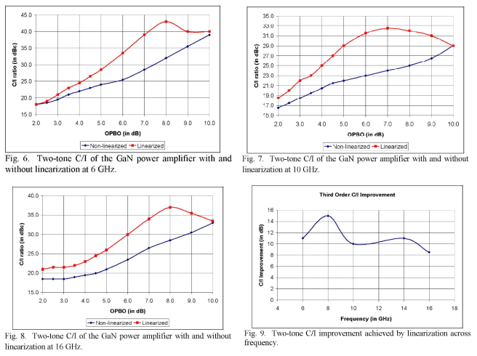
Wideband Transmissive Dual Path: Paper 1
Figures 6, 7, and 8 on the right are comparisons of the IMD3 of the non-linearized cascade and the linearized cascade at the low, mid, and high frequencies of the cascade at various levels of output power back off. Figure 9 on the right is the maximum IMD3 improvement at each frequency.

Slide 25
Outline
Category of GaN/TWTA Analog Pre-Distorter
Narrowband Reflective Single Path
Paper 1
Wideband Reflective Single Path
Paper 1
Wideband Transmissive Single Path
Paper 1 - 2
Wideband Transmissive Dual Path
Paper 1 - 4
Wideband Reflective Transmissive Dual Path
Paper 1
Wideband Unknown
Paper 1 – 2
Best State Of The Art Performance

Slide 26
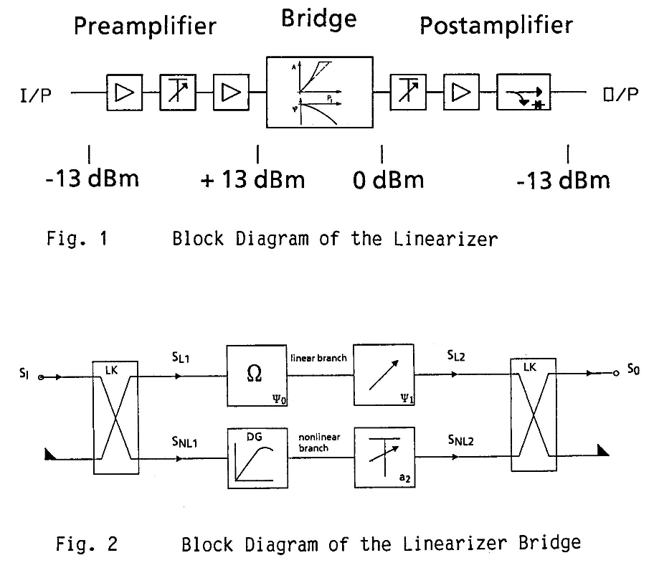
Wideband Transmissive Dual Path: Paper 2
The image on the right at the top is the linearizer system that linearizer topology this paper is using is implemented in while the image on the right at the bottom is the linearizer topology that this paper is demonstrating. This is a very old paper.

Slide 27
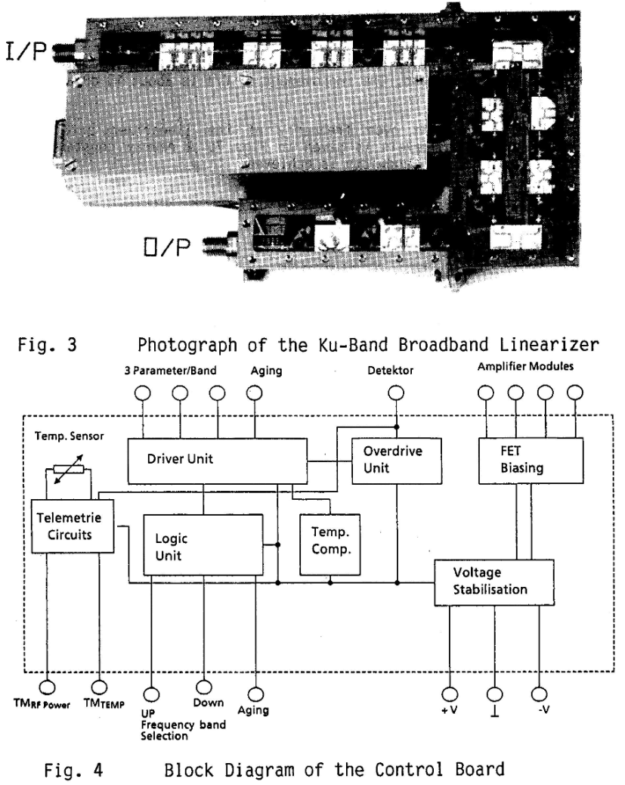
Wideband Transmissive Dual Path: Paper 2
The image on the right at the top is the physical implementation of the linearizer system presented in this paper while the image on the right at the bottom is the control system that the linearizer and amplifier system share.

Slide 28
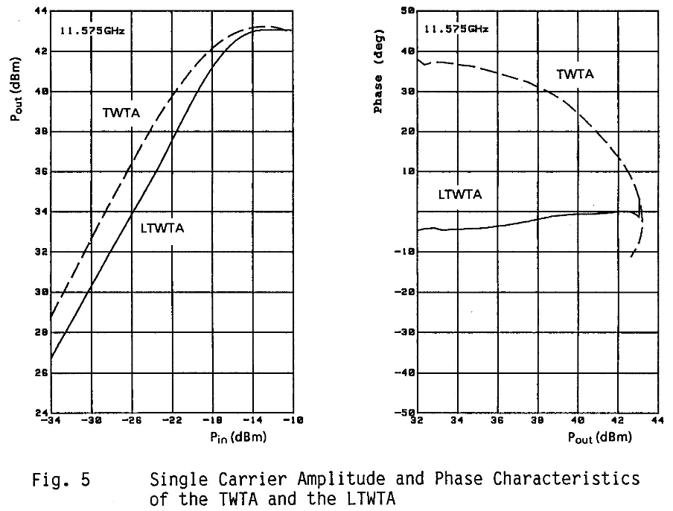
Wideband Transmissive Dual Path: Paper 2
The image on the right is a comparison of the power in – power out response and phase distortion response of the un-linearized and linearized cascade.

Slide 29
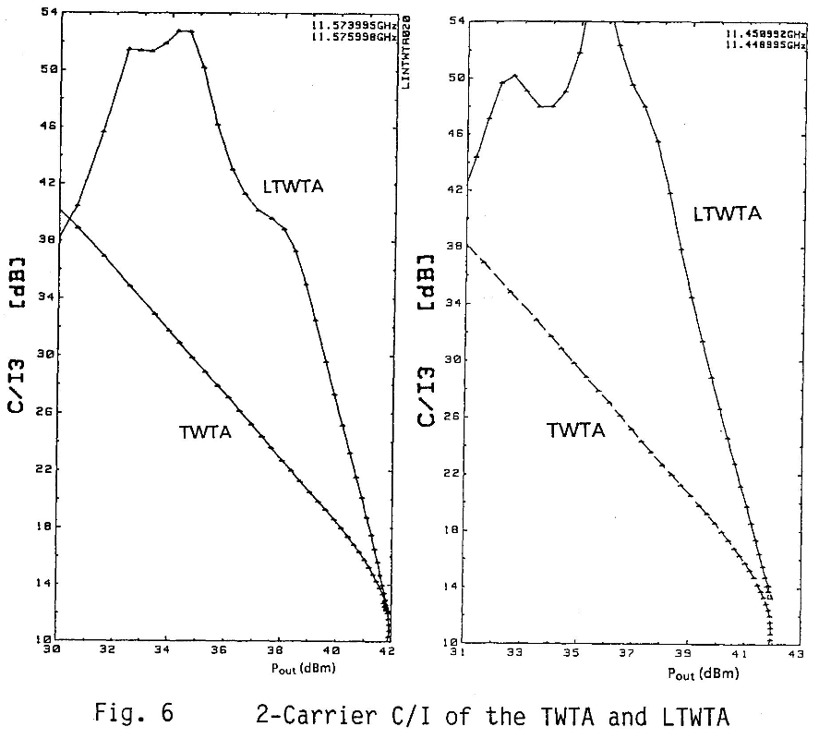
Wideband Transmissive Dual Path: Paper 2
The image on the right is a comparison of the IMD3 response of the non-linearized cascade and the linearized cascade at two different frequencies.

Slide 30
Outline
Category of GaN/TWTA Analog Pre-Distorter
Narrowband Reflective Single Path
Paper 1
Wideband Reflective Single Path
Paper 1
Wideband Transmissive Single Path
Paper 1 - 2
Wideband Transmissive Dual Path
Paper 1 - 4
Wideband Reflective Transmissive Dual Path
Paper 1
Wideband Unknown
Paper 1 – 2
Best State Of The Art Performance

Slide 31
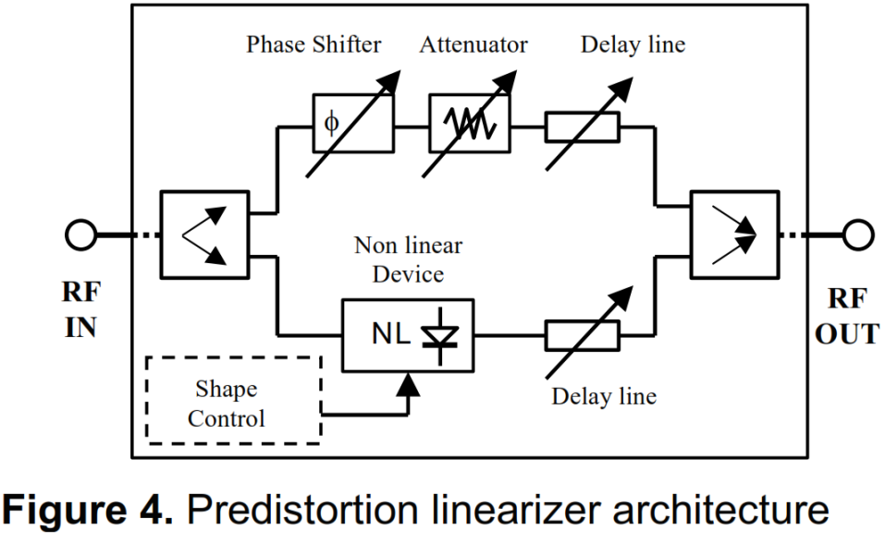
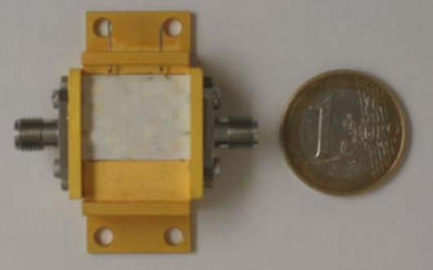
Wideband Transmissive Dual Path: Paper 3
The image on the right at the top is the linearizer topology that this paper is demonstrating. The paper is focused on this topology for it’s ability to more accurately correct for the nonlinearity of a TWTA through the addition of a shape control block.

Slide 32
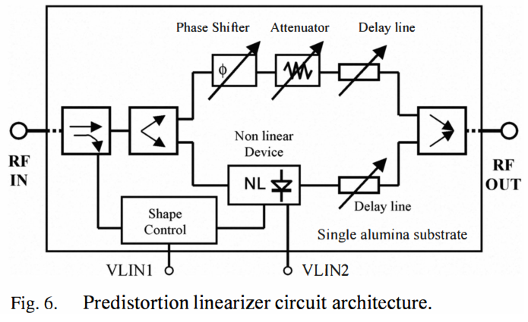
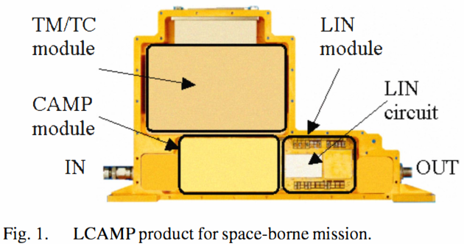
Wideband Transmissive Dual Path: Paper 3
The images on the right are the same linearizer circuit topology and physical topology as on the previous slide with the addition of some detail.

Slide 33
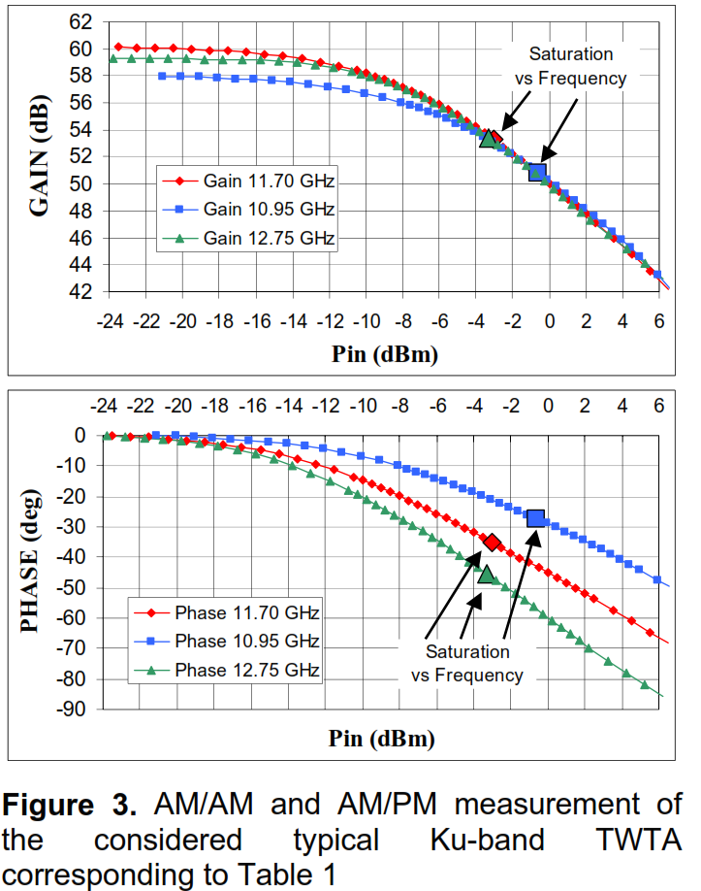
Wideband Transmissive Dual Path: Paper 3
The image on the right is the AM-AM and AM-PM response of the non-linearized cascade at the low, mid, and high frequencies of the cascade.

Slide 34
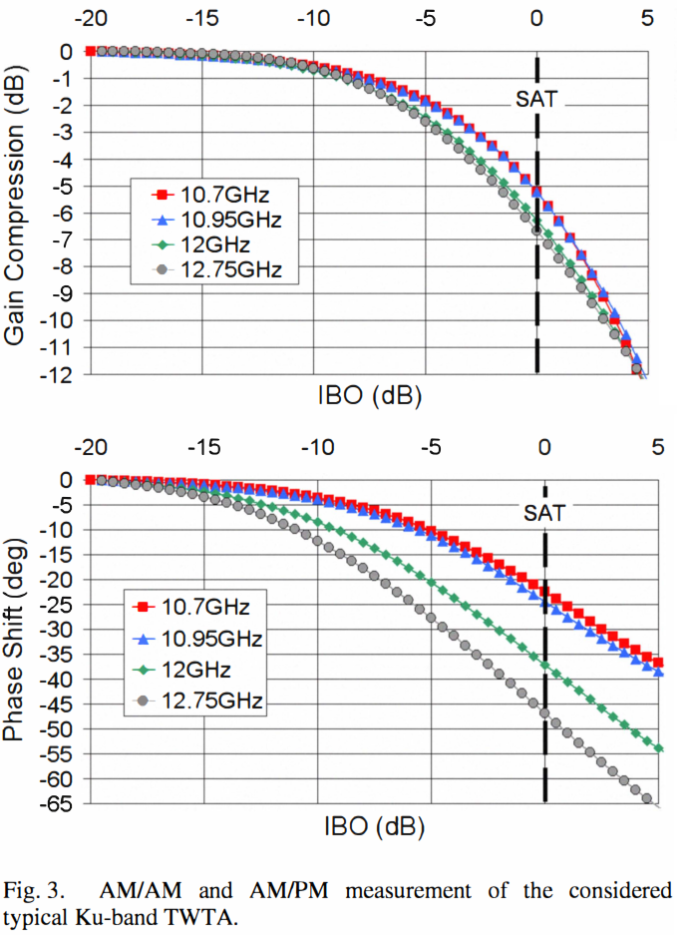
Wideband Transmissive Dual Path: Paper 4
The image on the right is the AM-AM and AM-PM response of the non-linearized cascade at the low, mid, and high frequencies of the cascade. Note: graphs are plotted vs IBO not OBO thereby improving the appearance of linearity.

Slide 35
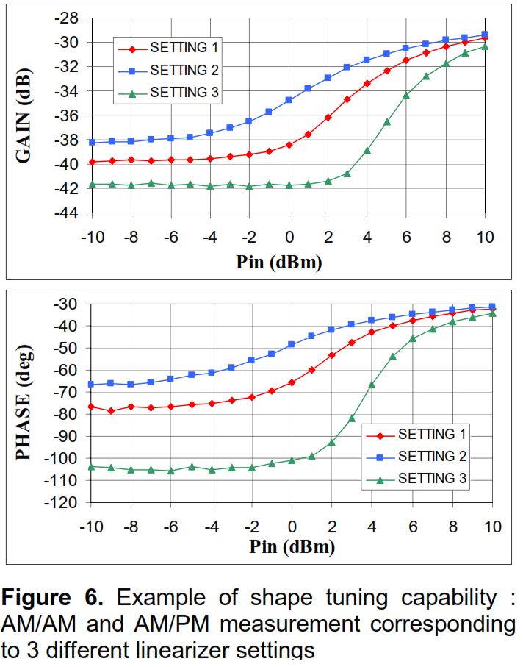
Wideband Transmissive Dual Path: Paper 3
The image on the right the AM-AM and AM-PM response of the linearizer at the low, mid, and high frequencies of the cascade.

Slide 36
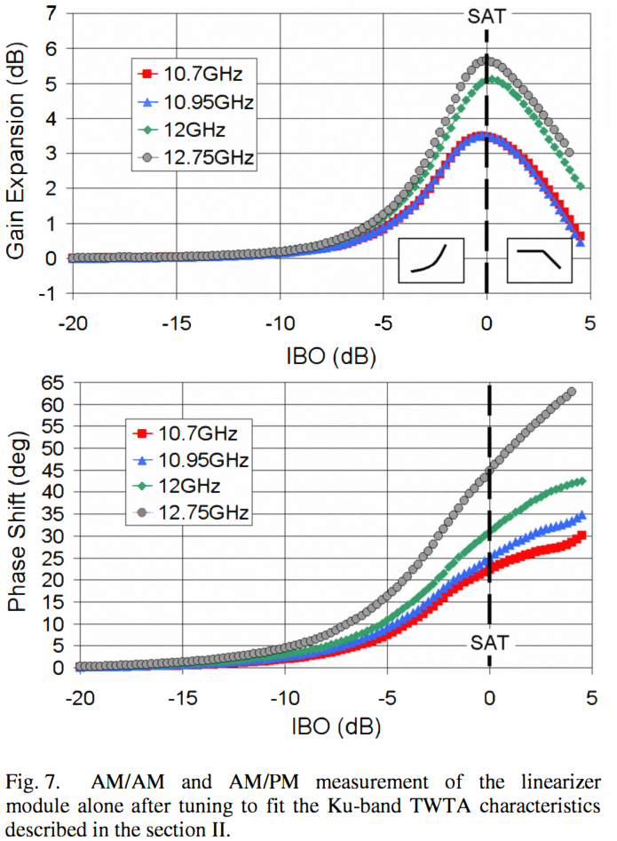
Wideband Transmissive Dual Path: Paper 3
The image on the right the AM-AM and AM-PM response of the linearizer at the low, mid, and high frequencies of the cascade. Note: graphs are plotted vs IBO not OBO thereby improving the appearance of linearity.

Slide 37
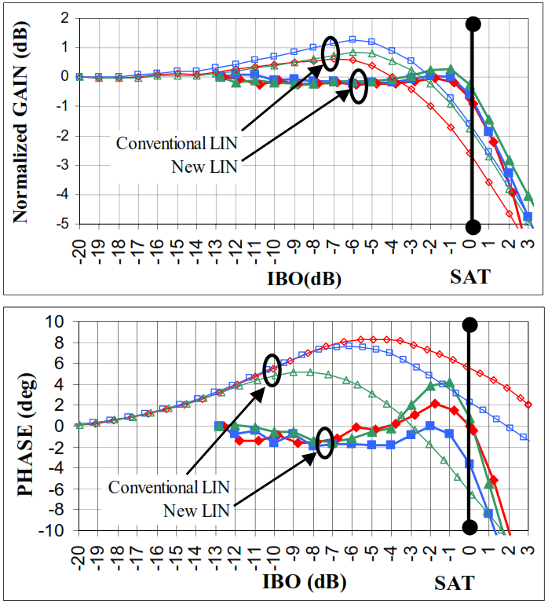
Wideband Transmissive Dual Path: Paper 3
The image on the right is a comparison of the AM-AM and AM-PM response of the linearized cascade without shape control and the linearized cascade with shape control at the low, mid, and high frequencies of the cascade. Note: graphs are plotted vs IBO not OBO thereby improving the appearance of linearity.

Slide 38
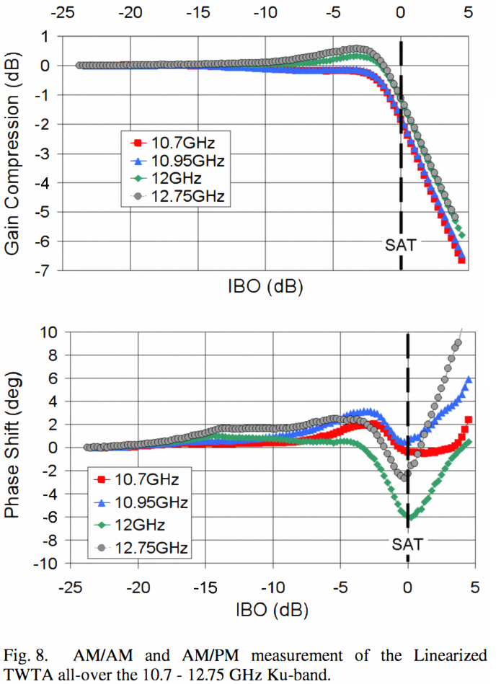
Wideband Transmissive Dual Path: Paper 3
The image on the right is a comparison of the AM-AM and AM-PM response of the linearized cascade with shape control at the low, mid, and high frequencies of the cascade. Note: graphs are plotted vs IBO not OBO thereby improving the appearance of linearity.

Slide 39
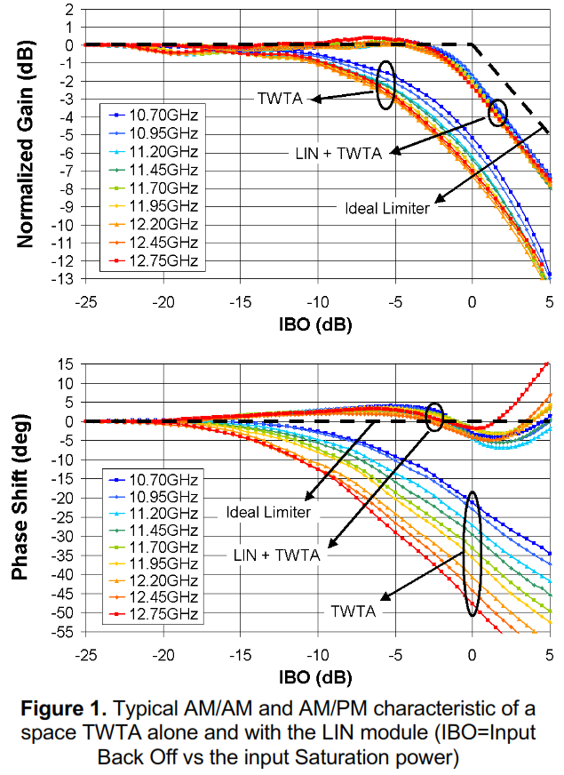
Wideband Transmissive Dual Path: Paper 3
The image on the right is a comparison of the AM-AM and AM-PM response of the linearized cascade with shape control at a more varied range of frequencies. Note: graphs are plotted vs IBO not OBO thereby improving the appearance of linearity.

Slide 40
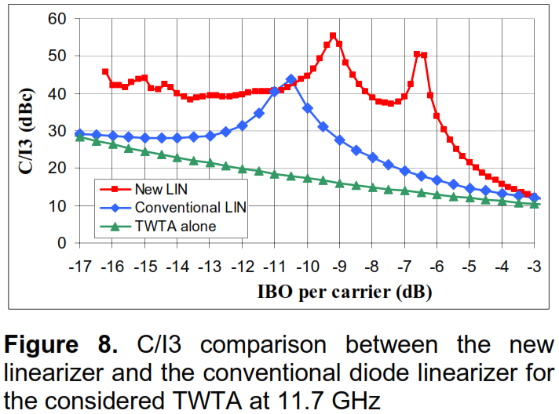
Wideband Transmissive Dual Path: Paper 3
The image on the right is a comparison of the IMD3 response of the un-linearized cascade, the linearized cascade without shape control, and the linearized cascade with shape control at the low, mid, and high frequencies of the cascade. Note: graphs are plotted vs IBO not OBO thereby improving the appearance of linearity.

Slide 41
Outline
Category of GaN/TWTA Analog Pre-Distorter
Narrowband Reflective Single Path
Paper 1
Wideband Reflective Single Path
Paper 1
Wideband Transmissive Single Path
Paper 1 - 2
Wideband Transmissive Dual Path
Paper 1 - 4
Wideband Reflective Transmissive Dual Path
Paper 1
Wideband Unknown
Paper 1 – 2
Best State Of The Art Performance

Slide 42
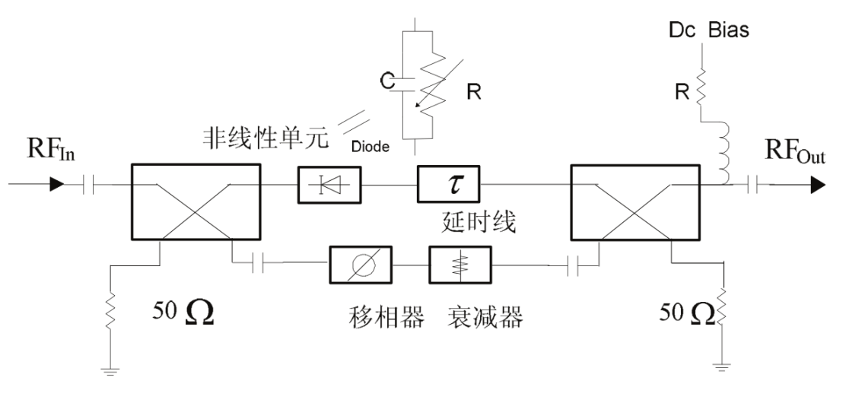
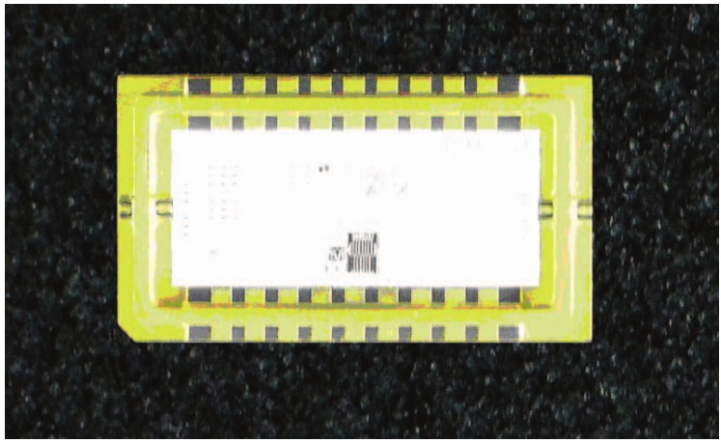
Wideband Transmissive Dual Path: Paper 4
The image on the right at the top is the linearizer topology that this paper is demonstrating. The paper is in Chinese so I do not know what the focus of the paper is on.

Slide 43
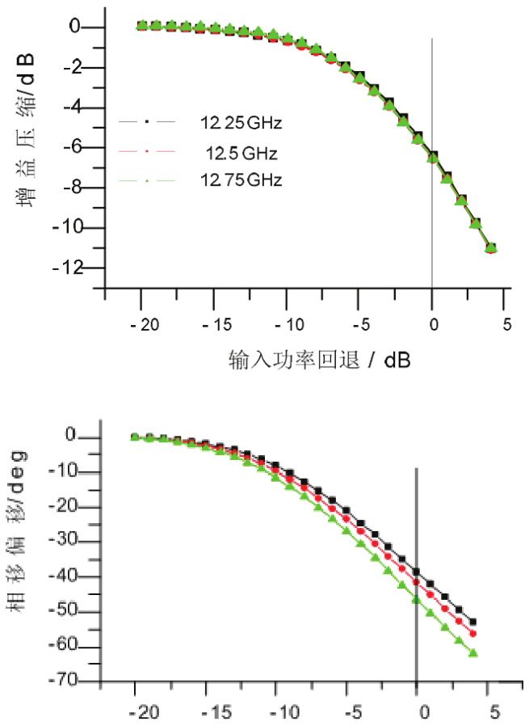
Wideband Transmissive Dual Path: Paper 4
The image on the right the AM-AM and AM-PM response of the un-linearized cascade at the low, mid, and high frequencies of the cascade.

Slide 44
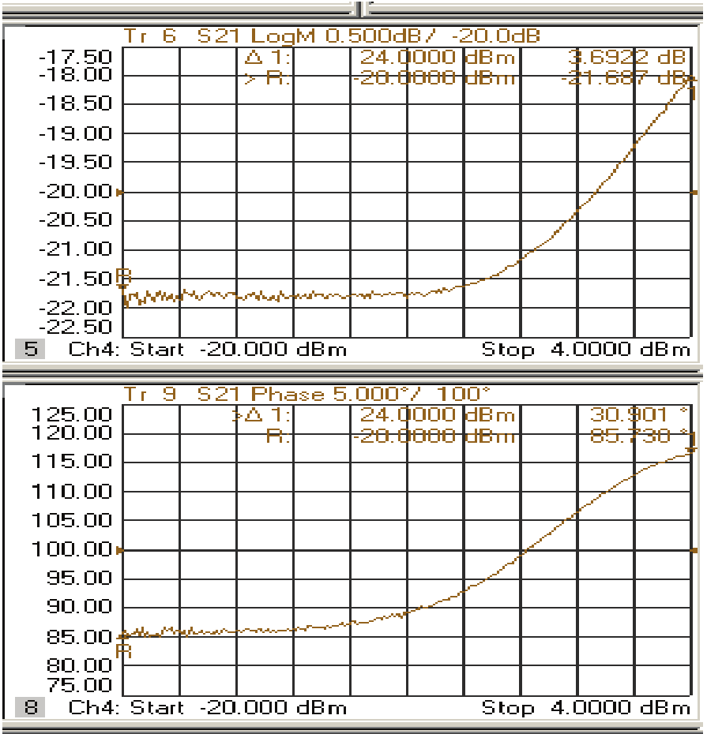
Wideband Transmissive Dual Path: Paper 4
The image on the right is a comparison of the AM-AM and AM-PM response of the linearizer at an unknown frequency.

Slide 45
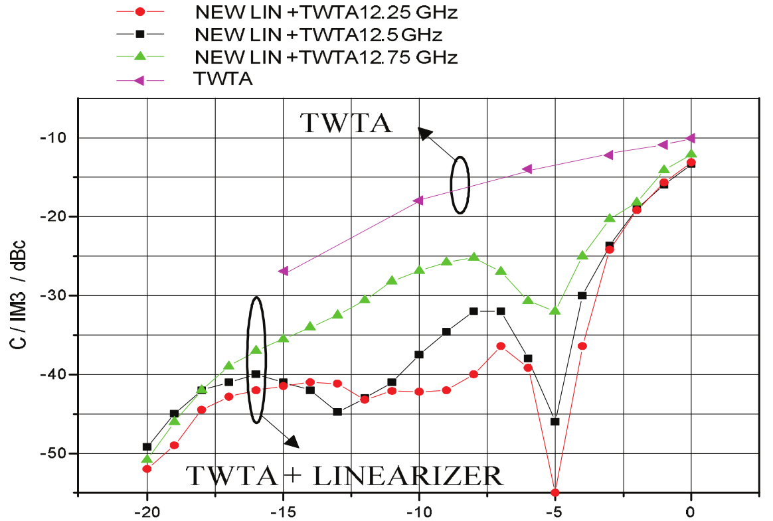
Wideband Transmissive Dual Path: Paper 4
The image on the right is a comparison of the IMD3 of the non-linearized cascade and the linearized cascade at the low, mid, and high frequencies of the cascade at various levels of output power back off.

Slide 46
Outline
Category of GaN/TWTA Analog Pre-Distorter
Narrowband Reflective Single Path
Paper 1
Wideband Reflective Single Path
Paper 1
Wideband Transmissive Single Path
Paper 1 - 2
Wideband Transmissive Dual Path
Paper 1 - 4
Wideband Reflective Transmissive Dual Path
Paper 1
Wideband Unknown
Paper 1 – 2
Best State Of The Art Performance

Slide 47
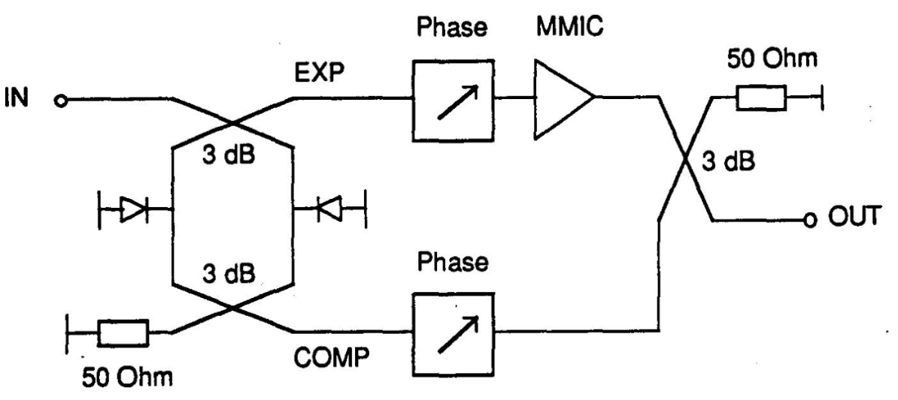
Wideband Reflective Transmissive Dual Path: Paper 1
The image on the right is the linearizer topology that this paper is demonstrating.

Slide 48
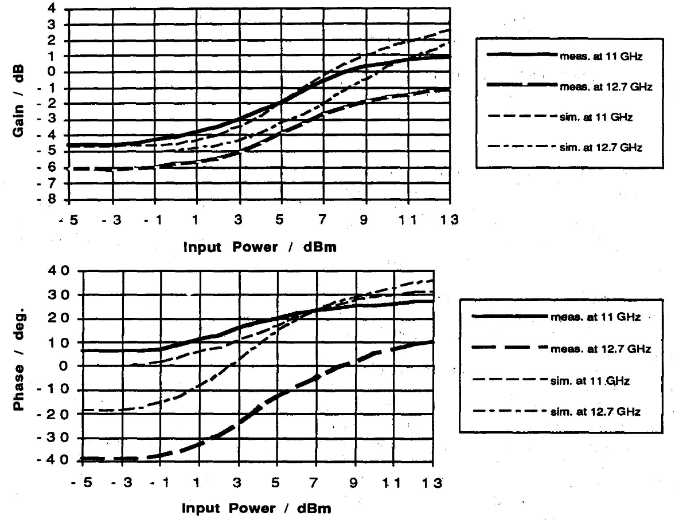
Wideband Reflective Transmissive Dual Path: Paper 1
The image on the right is a comparison of the measured and simulated AM-AM and AM-PM response of the linearizer at the low and high frequencies of the cascade.

Slide 49
Outline
Category of GaN/TWTA Analog Pre-Distorter
Narrowband Reflective Single Path
Paper 1
Wideband Reflective Single Path
Paper 1
Wideband Transmissive Single Path
Paper 1 - 2
Wideband Transmissive Dual Path
Paper 1 - 4
Wideband Reflective Transmissive Dual Path
Paper 1
Wideband Unknown
Paper 1 – 2
Best State Of The Art Performance

Slide 50
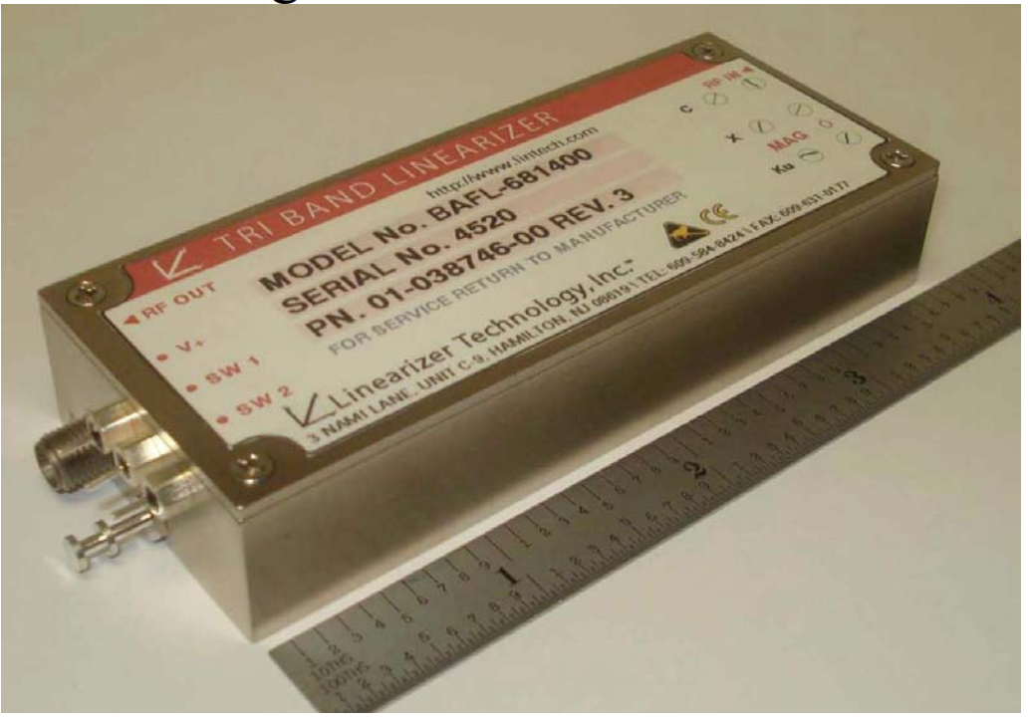
Wideband Unknown: Paper 1
The image on the right is the linearizer product in it’s final form that this paper is demonstrating. This paper was written to demonstrate the ability to make very wideband linearizers.

Slide 51

Wideband Unknown: Paper 1
The image on the right is a comparison of the AM-AM, power in – power out, and AM-PM response of the un-linearized cascade and the linearized cascade at the middle frequency of the middle band that the linearizer was designed for.

Slide 52

Wideband Unknown: Paper 1
The image on the right is a comparison of the IMD3 response of the un-linearized cascade and the linearized cascade at the three different bands that the linearizer was designed for.

Slide 53
Outline
Category of GaN/TWTA Analog Pre-Distorter
Narrowband Reflective Single Path
Paper 1
Wideband Reflective Single Path
Paper 1
Wideband Transmissive Single Path
Paper 1 - 2
Wideband Transmissive Dual Path
Paper 1 - 4
Wideband Reflective Transmissive Dual Path
Paper 1
Wideband Unknown
Paper 1 – 2
Best State Of The Art Performance

Slide 54

Wideband Unknown: Paper 2
The image on the right is the linearizer product in it’s final form that this paper is demonstrating.

Slide 55

Wideband Unknown: Paper 2
The image on the right is a comparison of the IMD3 response of the un-linearized cascade and the linearized cascade at 14.5GHz against output back off.

Slide 56
Outline
Category of GaN/TWTA Analog Pre-Distorter
Narrowband Reflective Single Path
Paper 1
Wideband Reflective Single Path
Paper 1
Wideband Transmissive Single Path
Paper 1 - 2
Wideband Transmissive Dual Path
Paper 1 - 4
Wideband Reflective Transmissive Dual Path
Paper 1
Wideband Unknown
Paper 1 – 2
Best State Of The Art Performance

Slide 57
Best State Of The Art Performance
Narrowband Reflective Single Path
Paper 1
Narrow Band
Not State Of Art

Slide 58
Best State Of The Art Performance
Wideband Reflective Single Path
Paper 1
Insufficient Control
Insufficient Results Presented
Not State Of Art

Slide 59
Best State Of The Art Performance
Wideband Transmissive Single Path
Paper 1
Phase Distortion For GaN Linearization Not Achievable
Not State Of Art
Paper 2
Insufficient Control
Insufficient Results Presented
Not State Of Art

Slide 60
Best State Of The Art Performance
Wideband Transmissive Dual Path
Paper 1
Extremely Wideband
Insufficient ACP Reduction
State Of The Art For Instantaneous Bandwidth
Not State Of The Art For ACP Reduction
Paper 2
Decent ACP Reduction At 200KHz Tone Spacing
Decent ACP Reduction At 2MHz Tone Spacing
250MHz Instantaneous Bandwidth
1.5GHz Small Signal Bandwidth
State Of The Art For ACP Reduction of TWTA
Paper 3
Tone Spacing Not Listed
Instantaneous Bandwidth Not Listed
2.05GHz Small Signal Bandwidth
State Of The Art For ACP Reduction of TWTA
Paper 4
Tone Spacing Not Comprehensible/Listed
Instantaneous Bandwidth Not Comprehensible/Listed
500MHz Small Signal Bandwidth
State Of The Art For ACP Reduction of TWTA

Slide 61
Best State Of The Art Performance
Wideband Reflective Transmissive Dual Path
Paper 1
No ACP Data Given
Instantaneous Bandwidth Not Listed
2GHz Small Signal Bandwidth
State Of The Art For ACP Reduction of TWTA

Slide 62
Best State Of The Art Performance
Wideband Unknown
Paper 1
Extremely Wideband
State Of The Art For Instantaneous Bandwidth and ACP Reduction of TWTA
Paper 2
Targeted At GaN
Insufficient Information Given For Any Conclusion

Slide 63
Best State Of The Art Performance
State Of The Art Best Performance Is:
Wideband Transmissive Dual Path
Paper 2
Paper 3
Paper 4
Wideband Reflective Transmissive Dual Path
Paper 1
Wideband Unknown
Paper 1

